Slide 1
Project Meeting - Initial Phase
Team Lotus

Slide 2
Webpage with Forms
Database
Input
Stored
Industry Partner

Slide 3
Webpage with Forms
Database
Connected
Access
WSU Official
(Logged in)
Provides data

Slide 4




?

Slide 5
Questions
Web Services :
https://www.wichita.edu/services/mrc/Web_Services/index.php
Proposal form and Support Form
Website Management of WSU
What kind of information should we store based on people?
User Types

Slide 6
Goals - Initial Phase
Database Design
ER diagram or UML model
Tables, Attributes (columns)
Web Page
Initial Prototype
Working Webpage - 2 forms

Slide 7






Product Purchases
App Purchases
PURCHASE_ID
APP_ID
Many
USER_ID
Many
USER_ID
Date
Date
orderTotal
Users
paymentType
isOnline
“Purchases”
lastName
“Buys”
One
firstName
“Contains”
One
address
Subscriptions
phone
“Subscribes”
Many
DOB
One
subName
Purchase Details
appleId (email)
Many
ExpiryDate
password
plan
“Has”
PRODUCT_ID (model)
USER_ID
USER_ID
PURCHASE_ID
One
quantity
“Owns”
Many
Many
Apps
“Includes”
One
User’s Devices
APP_ID
name
Store Products
deviceName
developer
One
PRODUCT_ID (model)
size
productName
Location
price
PRODUCT_ID (model)
USER_ID
ratings (avg)
type (iOS or macOS ..)
SERIAL_NUM
hasInAppPurchases
price
isLost
hasAds

Slide 8
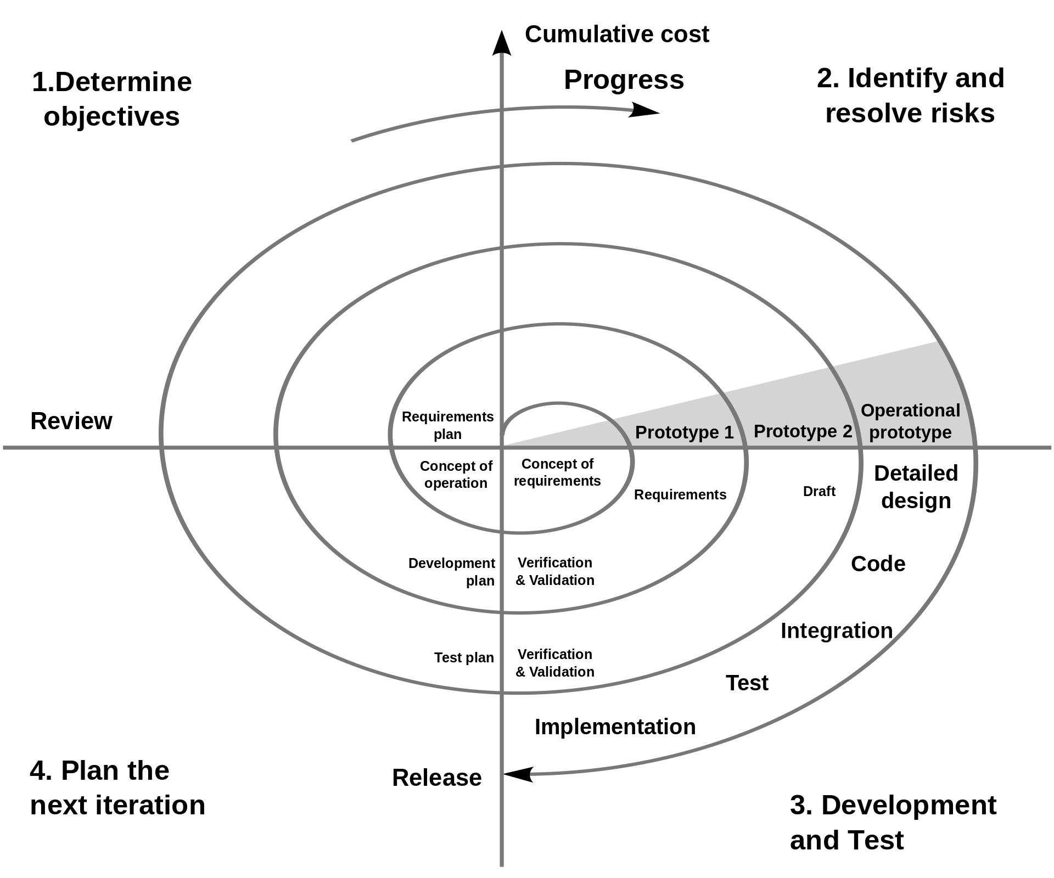

Slide 9
Work Division - Synchronize and Stabilize
Design - Layout
Comments
Style
Testing
Responsive
Functionality
Pair Programming

Slide 10

Contacts
Entry_ID (int) pk
prefix
first_name
last_name
email
phone_number (int)
college
current_status
Linkedin
Workplace
Title
Notes
timestamp_submitted
(tmsp)

Slide 11
Thank you
Team Lotus

